Slide 1
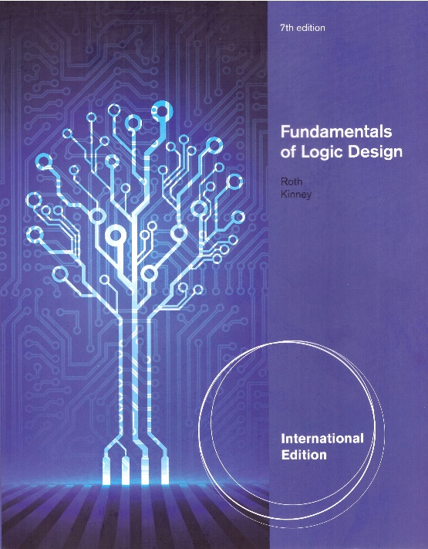
Unit 14
Derivation of State Graphs and Tables
This chapter in the book includes:
Objectives
Study Guide
14.1 Design of a Sequence Detector
14.2 More Complex Design Problems
14.3 Guidelines for Construction of State Graphs
14.4 Serial Data Code Conversion
14.5 Alphanumeric State Graph Notation
Programmed Exercises
Problems

Slide 2
Objectives
Given a problem statement for the design of a Mealy or Moore
sequential circuit, find the corresponding state graph and table.
2. Explain the significance of each state in your graph or table
in terms of the input sequences required to reach that state.
3. Check your state graph using appropriate input sequences.

Slide 3
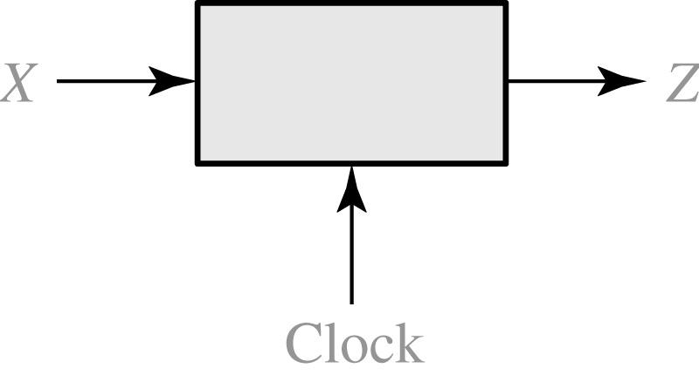
14.1 Design of a Sequence Detector
Fig 14-1 Sequence Detector (finding ‘101’) to be Designed
Search engine
Chat GPT
X = | 0 | 0 | 1 | 1 | 0 | 1 | 1 | 0 | 0 | 1 | 0 | 1 | 0 | 1 | 0 | 0
Z = | 0 | 0 | 0 | 0 | 0 | 1 | 0 | 0 | 0 | 0 | 0 | 1 | 0 | 1 | 0 | 0
(time: | 0 | 1 | 2 | 3 | 4 | 5 | 6 | 7 | 8 | 9 | 10 | 11 | 12 | 13 | 14 | 15)
Notes:
avian influenza virus

Slide 4
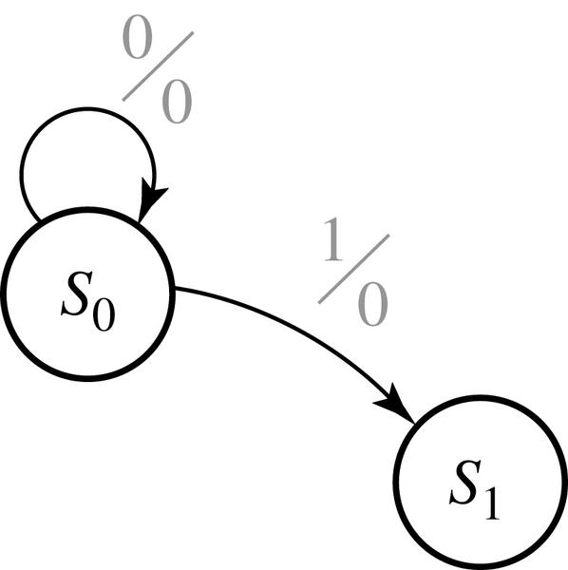
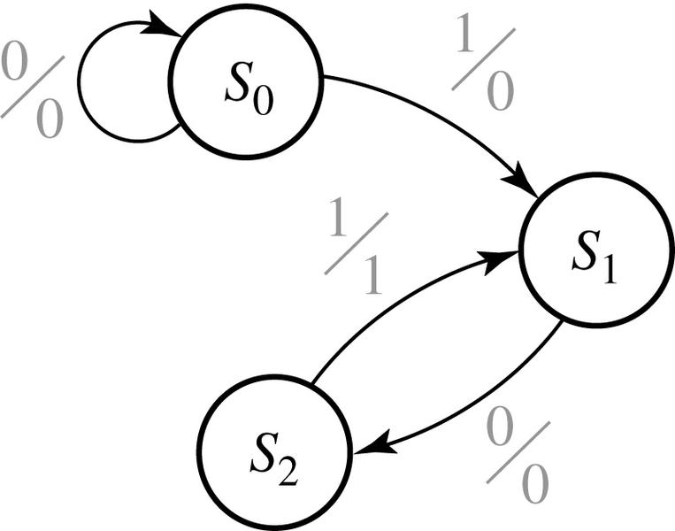
14.1 Design of a Sequence Detector
Fig 14-2 & 14-3 Formation of State Graph (finding ‘101’) (Mealy)
Stand by
Fire
Peace
Alarm
X = | 0 | 0 | 1 | 1 | 0 | 1 | 1 | 0 | 0 | 1 | 0 | 1 | 0 | 1 | 0 | 0
Z = | 0 | 0 | 0 | 0 | 0 | 1 | 0 | 0 | 0 | 0 | 0 | 1 | 0 | 1 | 0 | 0
(time: | 0 | 1 | 2 | 3 | 4 | 5 | 6 | 7 | 8 | 9 | 10 | 11 | 12 | 13 | 14 | 15)

Slide 5
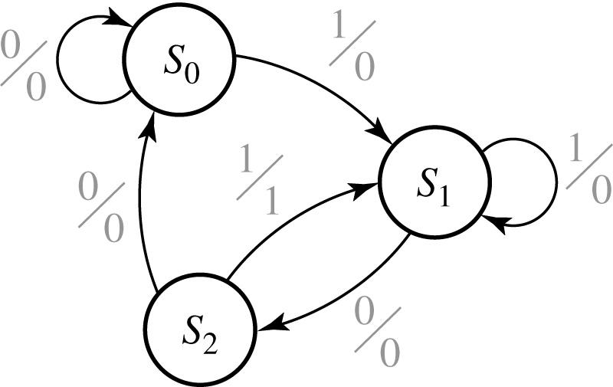
14.1 Design of a Sequence Detector
Fig 14-4 Mealy State Graph for Sequence Detector (finding ‘101’)
X = | 0 | 0 | 1 | 1 | 0 | 1 | 1 | 0 | 0 | 1 | 0 | 1 | 0 | 1 | 0 | 0
Z = | 0 | 0 | 0 | 0 | 0 | 1 | 0 | 0 | 0 | 0 | 0 | 1 | 0 | 1 | 0 | 0
(time: | 0 | 1 | 2 | 3 | 4 | 5 | 6 | 7 | 8 | 9 | 10 | 11 | 12 | 13 | 14 | 15)

Slide 6
14.1 Design of a Sequence Detector
Table 14-1 State Table
Present state |  | Next State |  | Present Output
 |  | X = 0 | X = 1 | X = 0 | X =1
S₀ S₁ S₂ |  | S₀ S₂ S₀ | S₁ S₁ S₁ | 0 0 0 | 0 0 1
Table 14-2 Transition Table with State Assignment
AB |  | A⁺ B⁺ |  | Z
 |  | X = 0 | X = 1 | X = 0 | X =1
00 01 10 |  | 00 10 00 | 01 01 01 | 0 0 0 | 0 0 1

Slide 7
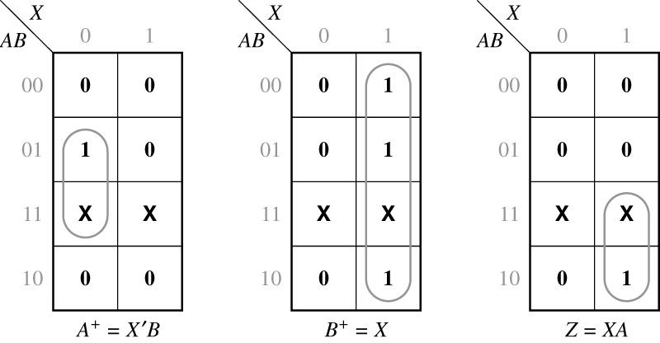
14.1 Design of a Sequence Detector
Maps for the next states A⁺ and B⁺ and the output function Z

Slide 8
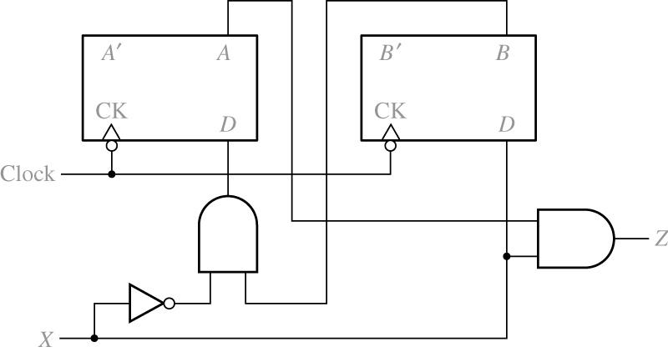
14.1 Design of a Sequence Detector
Fig 14-5 Final Circuit

Slide 9
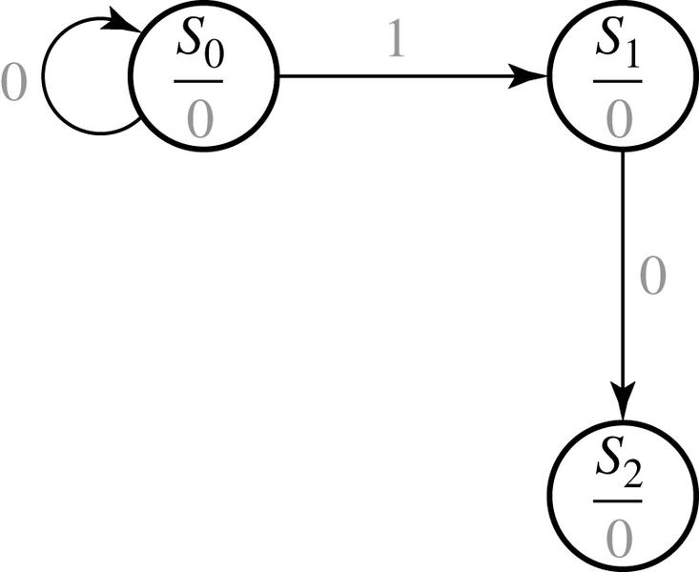
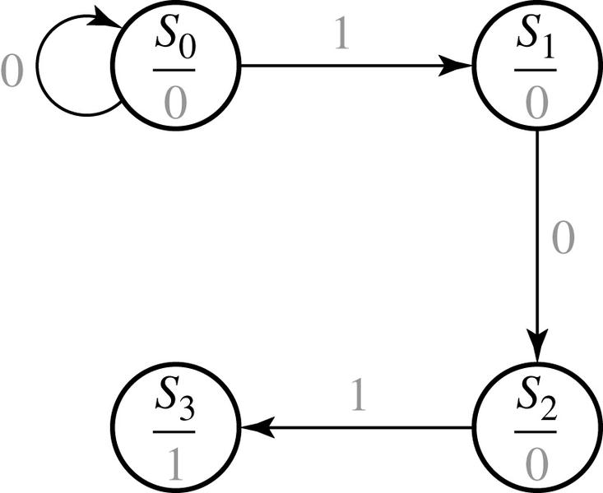
14.1 Design of a Sequence Detector
Moore Machine Design Process
Peace
Stand by
Fire
Alarm
X = | 0 | 0 | 1 | 1 | 0 | 1 | 1 | 0 | 0 | 1 | 0 | 1 | 0 | 1 | 0 | 0
Z = | 0 | 0 | 0 | 0 | 0 | 1 | 0 | 0 | 0 | 0 | 0 | 1 | 0 | 1 | 0 | 0
(time: | 0 | 1 | 2 | 3 | 4 | 5 | 6 | 7 | 8 | 9 | 10 | 11 | 12 | 13 | 14 | 15)

Slide 10
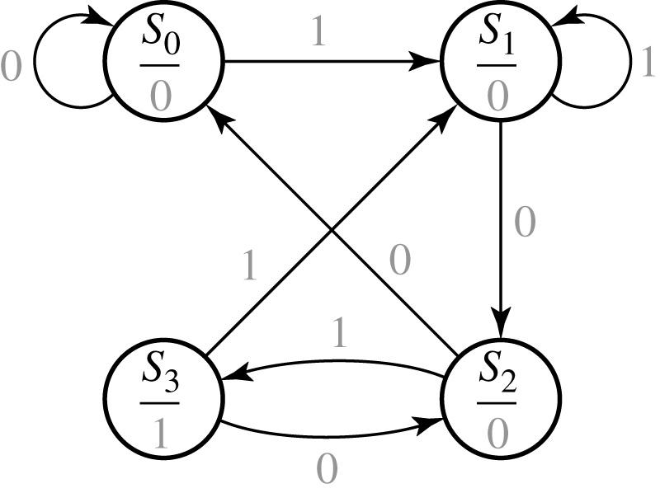
14.1 Design of a Sequence Detector
Fig 14-6 Moore State Graph for Sequence Detector
Each state includes output.
That’s why Moore type has one more state (S₃)
X = | 0 | 0 | 1 | 1 | 0 | 1 | 1 | 0 | 0 | 1 | 0 | 1 | 0 | 1 | 0 | 0
Z = | 0 | 0 | 0 | 0 | 0 | 1 | 0 | 0 | 0 | 0 | 0 | 1 | 0 | 1 | 0 | 0
(time: | 0 | 1 | 2 | 3 | 4 | 5 | 6 | 7 | 8 | 9 | 10 | 11 | 12 | 13 | 14 | 15)

Slide 11
14.1 Design of a Sequence Detector
Table 14-3 State Table
Table 14-4 Transition Table with State assignment
Present state |  | Next State |  | Present Output (Z)
 |  | X = 0 | X = 1
S₀ S₁ S₂ S₃ |  | S₀ S₂ S₀ S₂ | S₁ S₁ S₃ S₁ | 0 0 0 1
AB |  | A⁺ B⁺ |  | Z
 |  | X = 0 | X = 1
00 01 11 10 |  | 00 11 00 11 | 01 01 10 01 | 0 0 0 1
10
11
11
01

Slide 12
14.2 More Complex Design Problems
The circuit to be designed (Mealy):
Output Z=1 if input sequence ends in either 010 or 1001
X= | 0 | 0 | 1 | 0 | 1 | 0 | 0 | 1 | 0 | 0 | 0 | 1 | 0 | 0 | 1 | 1 | 0
 |  |  |  | ↑ |  | ↑ |  | ↑ | ↑ |  |  |  | ↑ |  | ↑
 |  |  |  | a |  | b |  | c | d |  |  |  | e |  | f
Z= | 0 | 0 | 0 | 1 | 0 | 1 | 0 | 1 | 1 | 0 | 0 | 0 | 1 | 0 | 1 | 0 | 0

Slide 13
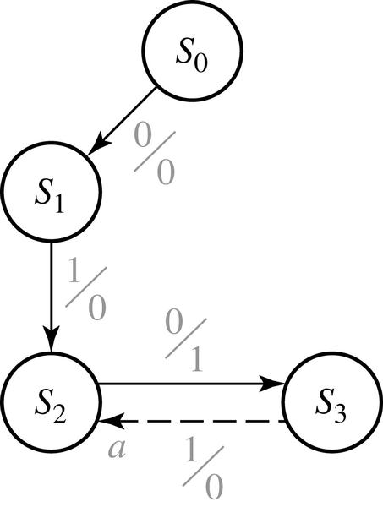
14.2 More Complex Design Problems
Fig 14-8 Formation of state graph (step1)
010 or 1001
state
sequence received
S₀
S₁
S₂
S₃
reset
0
01
010
No inputs
X= | 0 | 0 | 1 | 0 | 1 | 0 | 0 | 1 | 0 | 0 | 0 | 1 | 0 | 0 | 1 | 1 | 0
 |  |  |  | ↑ |  | ↑ |  | ↑ | ↑ |  |  |  | ↑ |  | ↑
 |  |  |  | a |  | b |  | c | d |  |  |  | e |  | f
Z= | 0 | 0 | 0 | 1 | 0 | 1 | 0 | 1 | 1 | 0 | 0 | 0 | 1 | 0 | 1 | 0 | 0

Slide 14
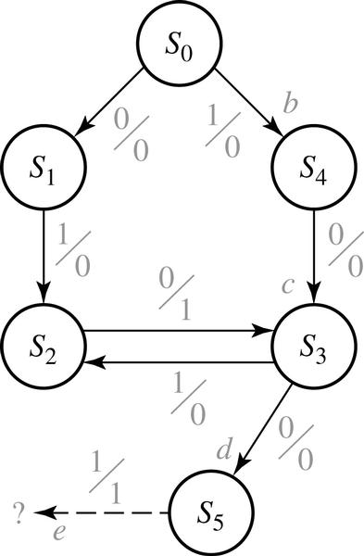
14.2 More Complex Design Problems
Fig 14-9 Formation of state graph (step2)
010 or 1001
state
sequence ends in
S₀
S₁
S₂
S₃
S₄
S₅
reset
0 (but not 10)
01
10
1 (but not 01)
100

Slide 15
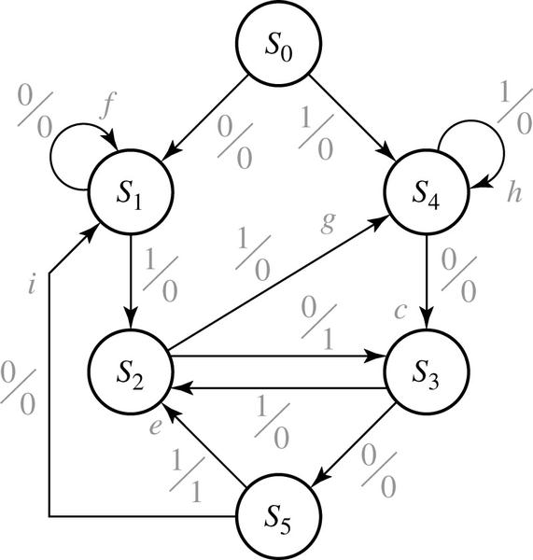
14.2 More Complex Design Problems
Fig 14-10 Completed State Graph for a Sequence Detector to be Designed
010 or 1001
state
sequence ends in
S₀
S₁
S₂
S₃
S₄
S₅
reset
0 (but not 10)
01
10
1 (but not 01)
100

Slide 16
14.2 More Complex Design Problems
The circuit to be designed (Moore)
Output Z=1 if the total number of 1’s received is odd and at least two consecutive 0’s have been received
X = | 1 | 0 | 1 | 1 | 0 | 0 | 1 | 1
 | ↑ |  |  | ↑ |  | ↑ | ↑ | ↑
 | a |  |  | b |  | c | d | e
Z = | (0) | 0 | 0 | 0 | 0 | 1 | 0 | 1

Slide 17

14.2 More Complex Design Problems
Fig 14-11 Formation of state graph (step1)

Slide 18
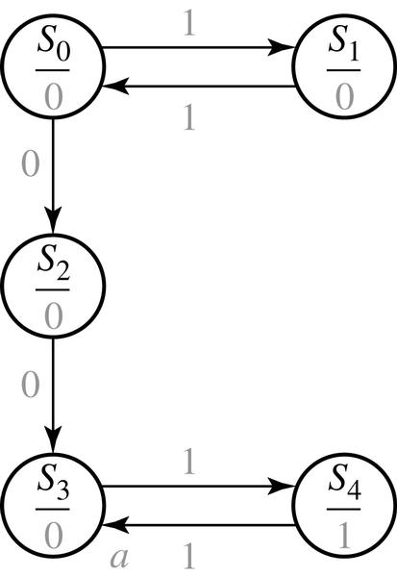
14.2 More Complex Design Problems
Fig 14-12 Formation of state graph (step2)
state | sequence ends in
S₀ S₁ S₂ S₃ S₄ | reset or even 1’s odd 1’s even 1’s and ends in 0 even 1’s and 00 has occurred 00 has occurred and odd 1’s

Slide 19
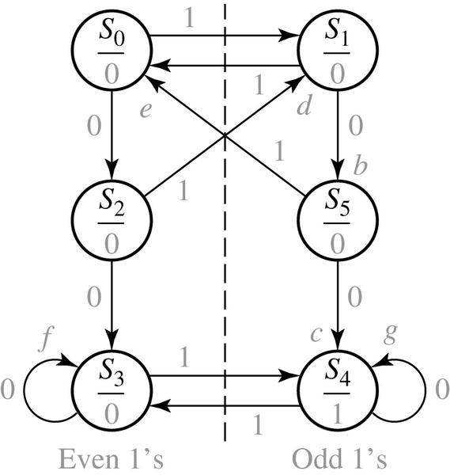
14.2 More Complex Design Problems
Fig 14-13 Completed State Graph for a Sequence Detector to be Designed
state | sequence ends in
S₀ S₁ S₂ S₃ S₄ S₅ | reset or even 1’s odd 1’s even 1’s and ends in 0 even 1’s and 00 has occurred odd 1’s and 00 has occurred odd 1’s and ends in 0

Slide 20
14.3 Guidelines for Construction of State Graphs
1. Construct some sample input and output sequences to make sure that you understand the problem statement.
2. Determine under what conditions the circuit should reset to its initial state.
3. If only one or two sequences lead to a non-zero output, a good way to start is to construct a partial state graph for those sequences.
4. Determine what sequences or groups of sequences must be remembered by the circuit and set up states accordingly.
5. Each time you add an arrow to the state graph, determine it can go to one of the previously defined states or whether a new state must be added.
6. Check your state graph to make sure there is one and only one path leaving each state for each combination of values of the input variables.
7. When your state graph is complete, test it by applying the input sequences formulated in part 1 and making sure the output sequences are correct.

Slide 21
14.3 Guidelines for Construction of State Graphs
Example 1: Z=1 when input sequence 0101 or 1001 occurs.
The circuit resets after every four inputs. (Mealy Circuit)
A typical sequence of input and output
X = | 0101 | 0010 | 1001 | 0100
Z = | 0001 | 0000 | 0001 | 0000

Slide 22
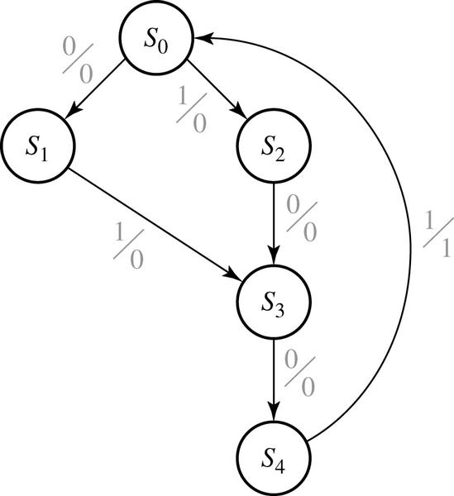
14.3 Guidelines for Construction of State Graphs
Fig 14-14 Partial State Graph for Example 1
Targets : 0101 or 1001
Target 1 : 0101
state | sequence received
S₀ S₁ S₂ S₃ S₄ | Reset 0 1 01 or 10 010 or 100

Slide 23
14.3 Guidelines for Construction of State Graphs
Fig 14-14 Partial State Graph for Example 1
Target 2 : 1001
state | sequence received
S₀ S₁ S₂ S₃ S₄ | Reset 0 1 01 or 10 010 or 100

Slide 24
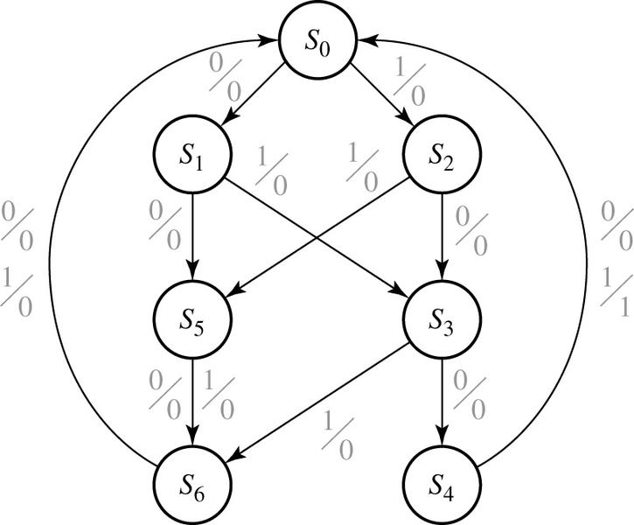
14.3 Guidelines for Construction of State Graphs
Fig 14-15 Complete State Graph for Example 1
0101 or 1001
state | sequence received
S₀ S₁ S₂ S₃ S₄ S₅ S₆ | Reset 0 1 01 or 10 010 or 100 two inputs received, no 1 output is possible three inputs received, no 1 output is possible

Slide 25
14.3 Guidelines for Construction of State Graphs
Example 2: Z1=1 every time the input sequence 100 is completed
Z2=1 every time the input sequence 010 is completed
Once Z2=1 occurred, Z1=1 can never occur but not vice versa
Mealy circuit
A typical sequence of input and output
X | = | 1 | 0 | 0 | 1 | 1 | 0 | 0 | 1 | 0 | 1 | 0 | 1 | 0 | 0 | 1 | 0 | 1 | 1 | 0 | 1 | 0 | 0
Z₁ | = | 0 | 0 | 1 | 0 | 0 | 0 | 1 | 0 | 0 | 0 | 0 | 0 | 0 | 0 | 0 | 0 | 0 | 0 | 0 | 0 | 0 | 0
Z₂ | = | 0 | 0 | 0 | 0 | 0 | 0 | 0 | 0 | 1 | 0 | 1 | 0 | 1 | 0 | 0 | 1 | 0 | 0 | 0 | 0 | 1 | 0

Slide 26
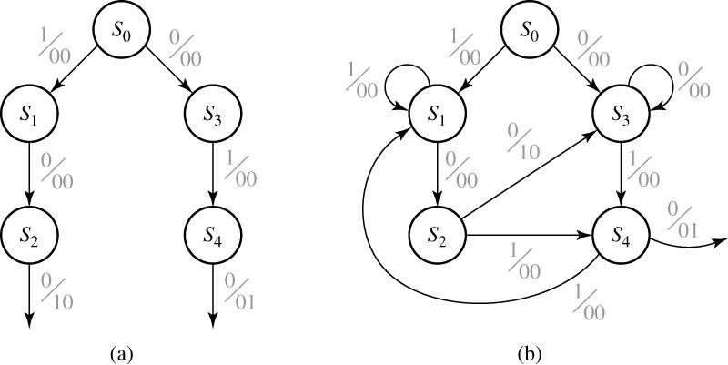
14.3 Guidelines for Construction of State Graphs
Fig 14-16 Partial Graphs for Example 2
100 or 010 Mealy

Slide 27
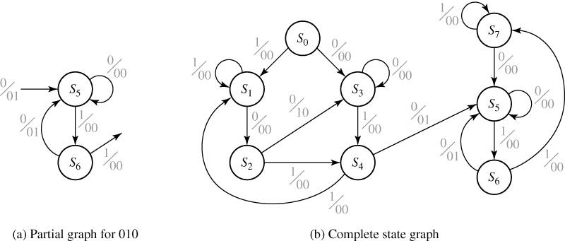
14.3 Guidelines for Construction of State Graphs
Fig 14-17 State Graphs for Example 2
100 or 010 Mealy

Slide 28
14.3 Guidelines for Construction of State Graphs
Table 14-5 State Descriptions for Example 2
stats | Description
S₀ S₁ S₂ S₃ S₄ | No progress on 100 Progress of 1 on 100 Progress of 10 on 100 No progress on 100 Progress of 10 on 100 | No progress on 010 No progress on 010 Progress of 0 on 010 Progress of 0 on 010 Progress of 01 on 010 | 010 has never occurred
S₅ S₆ S₇ |  | Progress of 0 on 010 Progress of 01 on 010 No progress on 010 | 010 has occurred

Slide 29
14.3 Guidelines for Construction of State Graphs
Table 14-6
Present state |  | Next X = 0 | State X = 1 |  | Output X = 0 | (Z₁ Z₂) X = 1
S₀ S₁ S₂ S₃ S₄ S₅ S₆ S₇ |  | S₃ S₂ S₃ S₃ S₅ S₅ S₅ S₅ | S₁ S₁ S₄ S₄ S₁ S₆ S₇ S₇ |  | 00 00 10 00 01 00 01 00 | 00 00 00 00 00 00 00 00

Slide 30
14.3 Guidelines for Construction of State Graphs
SKIPPED
Example 3: Two inputs – X1, X2, One output – Z
(a) The input sequence X1X2=01, 11 cause the output 0
(b) The input sequence X1X2=10, 11 cause the output 1
(c) The input sequence X1X2=10, 01 cause the output to change
Derive a Moore state graph
Previous Input (X₁X₂) | Output (Z) | State Designation
00 or 11 00 or 11 01 01 10 10 | 0 1 0 1 0 1 | S₀ S₁ S₂ S₃ S₄ S₅

Slide 31
14.3 Guidelines for Construction of State Graphs
Table 14-7 State table
Present |  | Z |  |  | Next state
State |  |  | X₁X₂ | = | 00 | 01 | 11 | 10
S₀ S₁ S₂ S₃ S₄ S₅ |  | 0 1 0 1 0 1 |  |  | S₀ S₁ S₀ S₁ S₀ S₁ | S₂ S₃ S₂ S₃ S₃ S₂ | S₀ S₁ S₀ S₀ S₁ S₁ | S₄ S₅ S₄ S₅ S₄ S₅

Slide 32
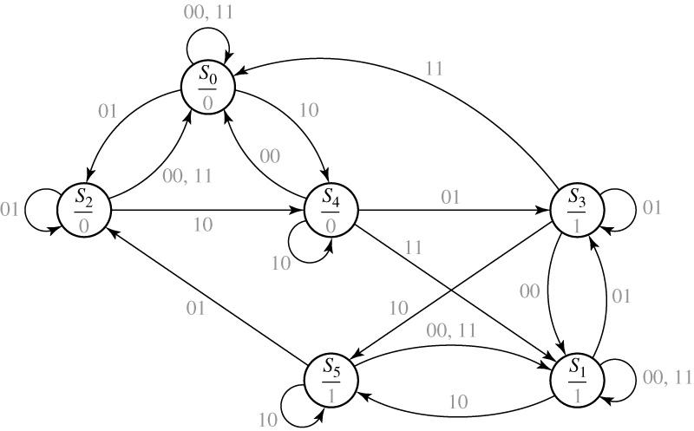
14.3 Guidelines for Construction of State Graphs
Fig 14-18 State Graph

Slide 33
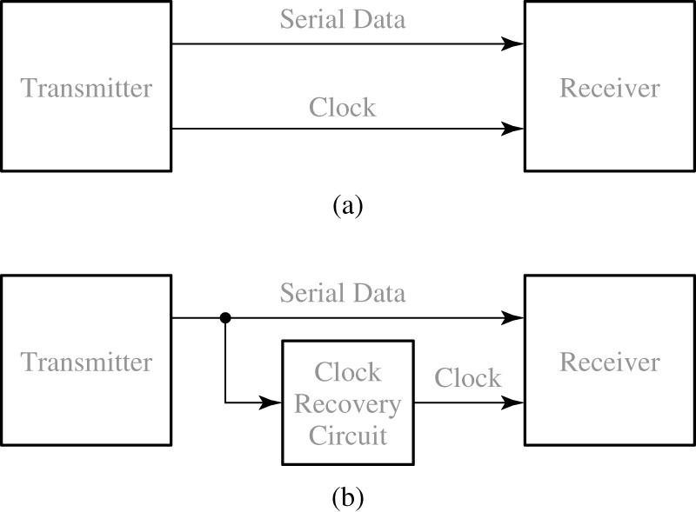
14.4 Serial Data Code Conversion
Fig 14-19 Serial Data Transmission

Slide 34
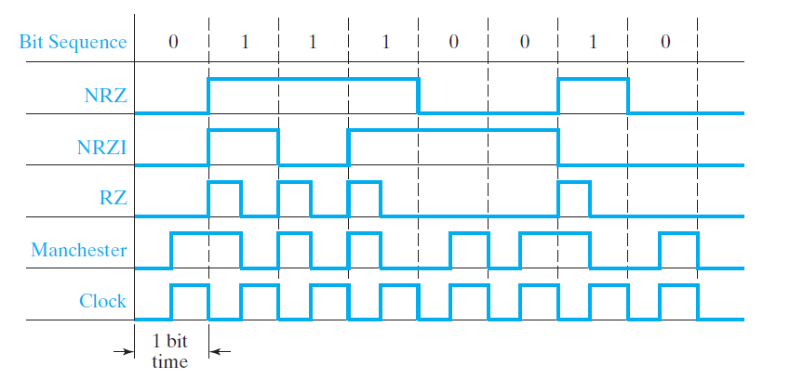

14.4 Serial Data Code Conversion
Fig 14-20 Coding Schemes for Serial Data Transmission
RZ : Return to Zero
NRZ: Non Return to Zero
NRZI: Non Return to Zero Inverted
Manchester: start with low for 0, with high for 1

Slide 35
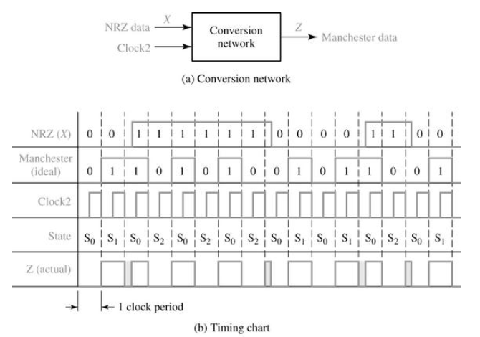
14.4 Serial Data Code Conversion
Fig 14-21 Mealy circuit for NRZ-to-Manchester Conversion
Clock2 = clock * 2
Actual transmitted bit-stream
0 1 1 1 0 0 1 0
Clock2 = Clock*2
glitch, hazard

Slide 36
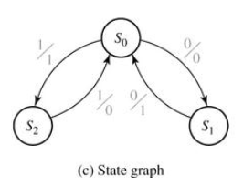
14.4 Serial Data Code Conversion
Fig 14-21 Mealy circuit for NRZ-to-Manchester Conversion
The only possible input sequences : “00” and “11”.
0
1
Present
Next State
Output (Z)
State
X = 0
X = 1
X = 0
X = 1
S₀
S₁
S₂
S₁
S₀
-
S₂
-
S₀
0
1
-
1
-
0
(d) State table

Slide 37
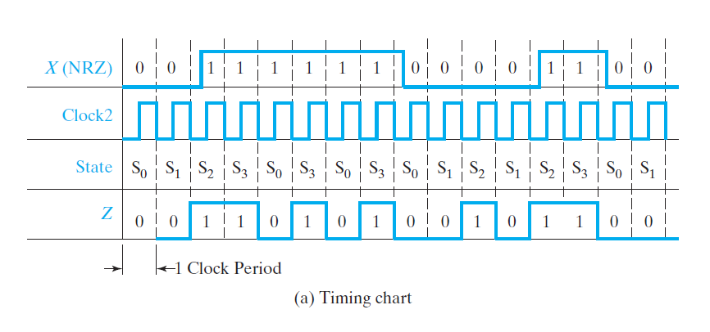
14.4 Serial Data Code Conversion
Fig 14-22 Moore Circuit for NRZ-to-Manchester Conversion
Falling edge
Actual transmitted bit-stream
0 1 1 1 0 0 1 0
1 clock delay, but no glitch
0 1 1 1 0 0 1 0

Slide 38
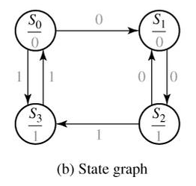
14.4 Serial Data Code Conversion
Fig 14-22 Moore Circuit for NRZ-to-Manchester Conversion
Present
Next State
Present
State
X = 0
X = 1
Output (Z)
No inputs
S₀
S₁
S₂
S₃
S₁
S₂
S₁
-
S₃
-
S₃
S₀
0
0
1
1
Single zero
Double zero
Single one
(c) State table

Slide 39
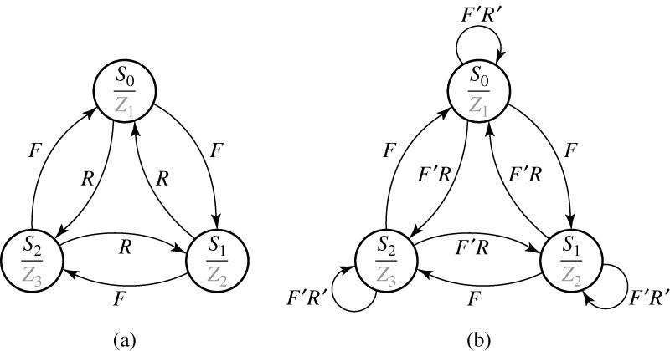
14.5 Alphanumeric State Graph Notation
Fig 14-23 State Graphs with Variable Names on Arc Labels
F: forward
R: reverse
F=R=0 (?)
F=R=1 (?)
F has higher priority

Slide 40
14.5 Alphanumeric State Graph Notation
Table 14-8 State Table for Fig 14-23
PS | NS |  |  |  |  | Output
 | FR = | 00 | 01 | 10 | 11 | Z₁ | Z₂ | Z₃
S₀ S₁ S₂ |  | S₀ S₁ S₂ | S₂ S₀ S₁ | S₁ S₂ S₀ | S₁ S₂ S₀ | 1 0 0 | 0 1 0 | 0 0 1
If we OR together all of the arc labels for state S₀, we get
If we AND together every possible pair of arc labels emanating from S₀, we get

Slide 41
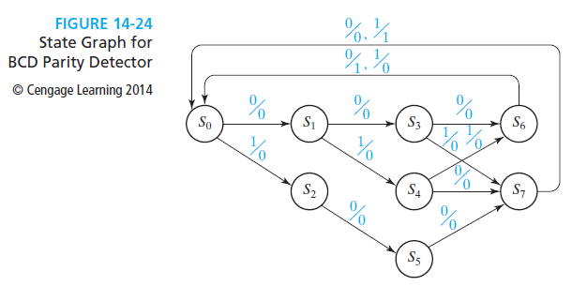
14.6 Incompletely Specified State Tables
BCD Parity Detector
A Mealy model sequential circuit examines the input sequence and generates an output of 1 when the last bit of a BCD digit is received if the parity of the digit is even;
Otherwise, the sequential circuit output is 0.

Slide 42
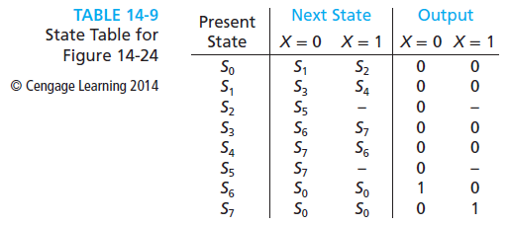
14.6 Incompletely Specified State Tables
BCD Parity Detector

Slide 43
14.6 Incompletely Specified State Tables
SG for BCD Parity Detector (Steve’s way)
S
0/1
1/0
S₀
0/0
1/1
state | Received & even/odd
S₀ S₁ S₂ S₃ S₄ S₅ S₆ S₇ | Reset 0 even 1 odd 00 even 01 odd 10 odd 011 even 001/100/010 odd
0/0
1/0
S
S
1/?
S₁
S₂
0/0
1/0
0/0
S
S
S
1/?
S₃
S₄
S₅
0/0
1/0
0/0
1/0
S
S
S₆
S₇
1/? -> out of BCD range -> Don’t cares

Slide 44
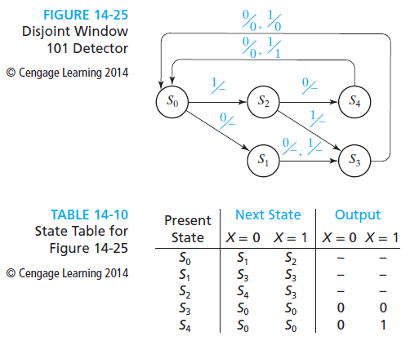
14.6 Incompletely Specified State Tables
101 Detector (Refer Section 15.5)

